Slide 1
LOCALMART(E-COMMERCE PLATFORM for local sellers)
Online hosted website link :- localmart.epizy.com
Student Name : J VEERESH NAIK
Roll no : 19885A0514

Slide 2


LocalMart
It is reasonable to say that the process of shopping on the web is becoming commonplace.
So, we provide a great online platform for local business to grow through LocalMart application.
The objective of this project is to develop a general purpose online store for local population where any kind of product can be bought from the comfort of home through the Internet. An online store is a virtual store on the Internet where customers can browse the catalog and select products of interest. The selected items may be collected in a shopping cart. At checkout time, the items in the shopping cart will be presented on order.

Slide 3


Advantages of LocalMart
• To break the barrier posed by physical limitations.
• To provide better customer relations and a trust with local sellers.
• To reach more shoppers in order to increase revenue.
• To make products available to customers 24/7 globally.
• To allow shoppers purchase goods at their own convenience, with just some mouse clicks.
• To reduce the operational cost of running a business.

Slide 4
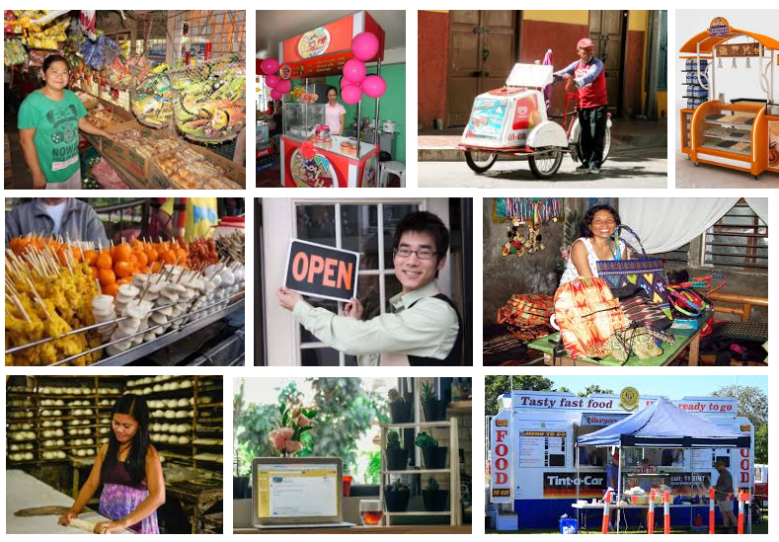

Slide 5
Huge business opportunity?
Number of small business in India: The number is estimated to be at 42.50 million, registered & unregistered together. A staggering 95% of the total industrial units in the country.
SME & Employment opportunity: Employs about 106 million, 40% of India’s workforce. Next only to the agricultural sector.
Products: produces more than 6000 products.
GDP Contribution: Currently around 6.11% of the manufacturing GDP and 24.63% of Service sector GDP

Slide 6

The whole project is divided into seven different modules;
I. Location module
2. Shopping Cart module
3. Shops module
4. Home page
5. Login / signup
6. Admin
7. Add products by admin
8.Secure Payment service
IMPLEMENTATION:

Slide 7

Users
Only registered user can perform actions either admin or normal user
We provide 3 roles
Seller(admin)
User
Visitor

Slide 8
locations
Stores
Product
Unregistered User
Cart
Settings
Registered User
Login
Registration
Seller
Add Products

Slide 9
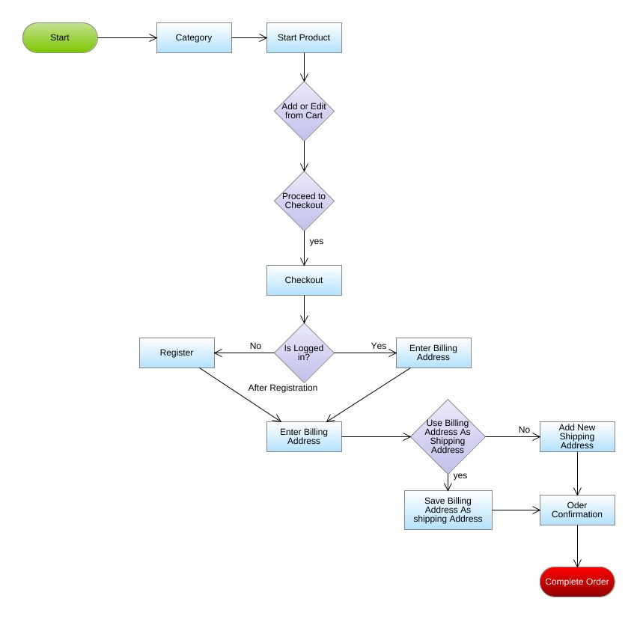
FLOW CHART OF USER:

Slide 10
SCREENSHOTS OF PROJECT

Slide 11
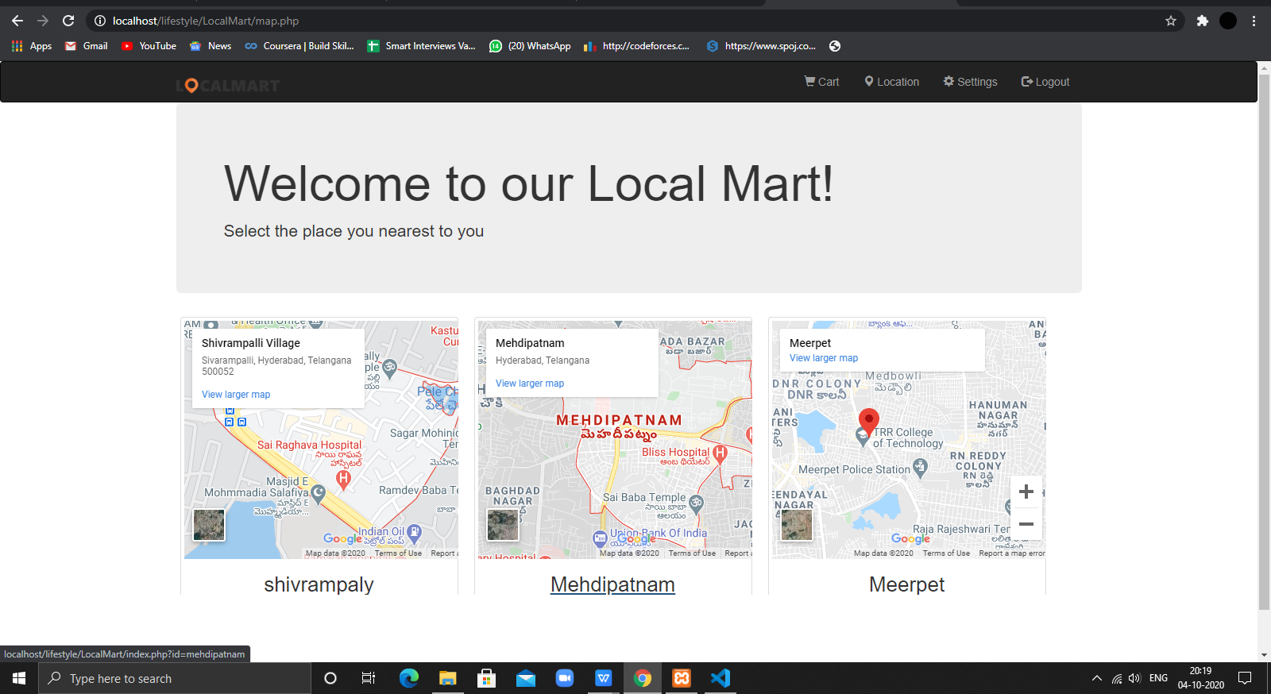

Slide 12
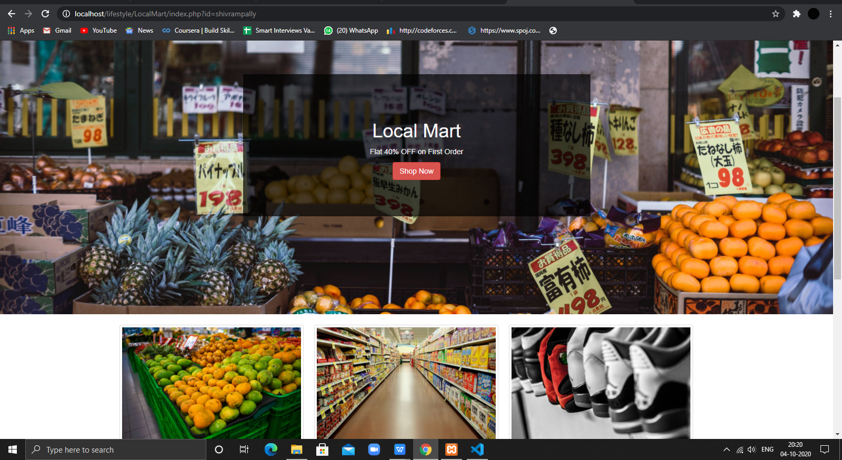

Slide 13
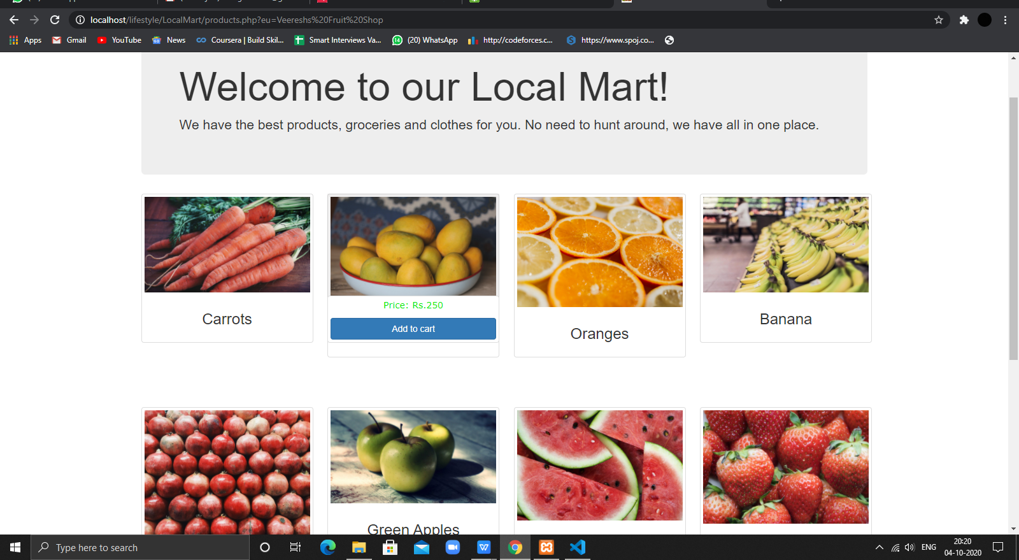

Slide 14
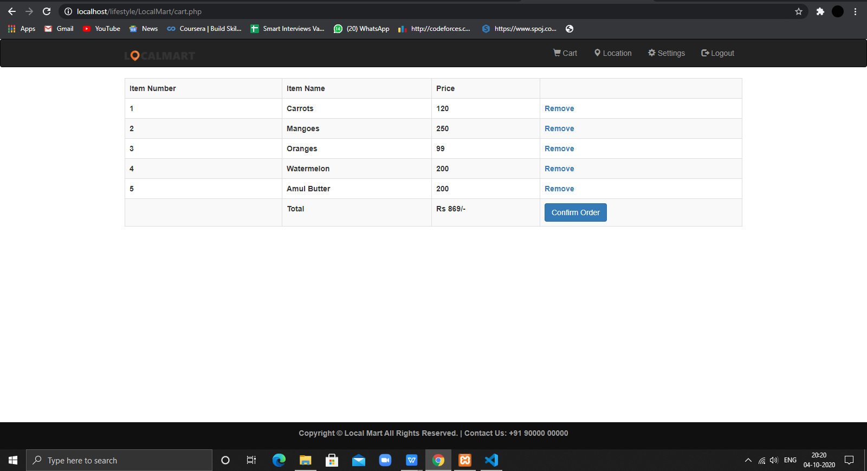

Slide 15
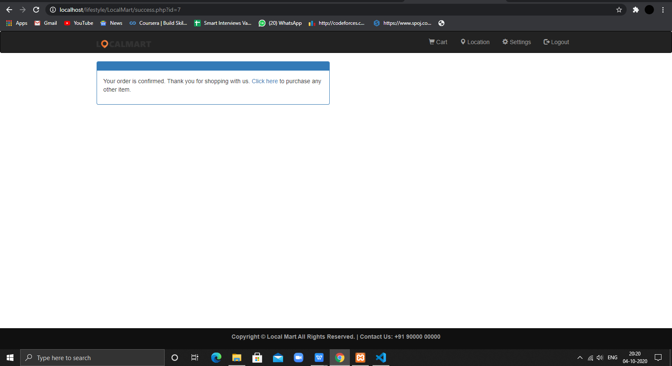

Slide 16
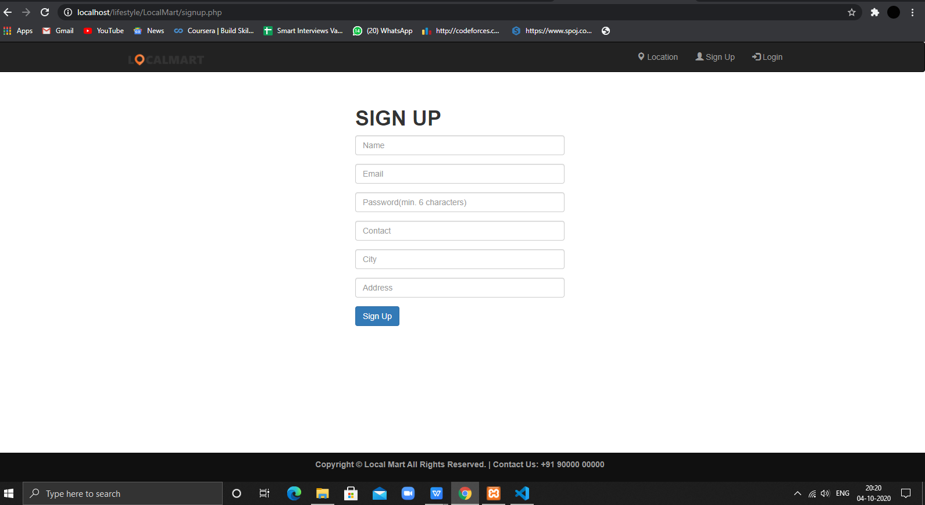

Slide 17
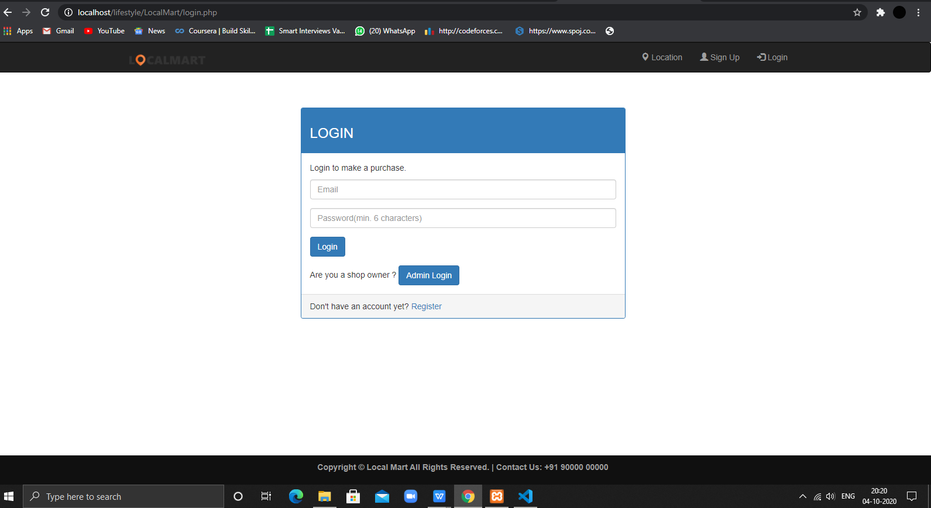

Slide 18
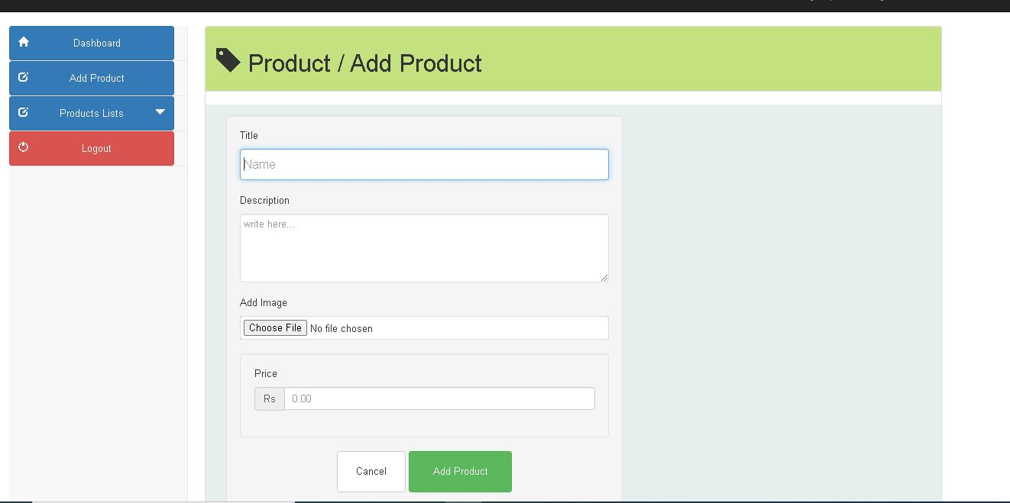

Slide 19
Thank you

